Slide 1

Using Recurrent Neural Networks to Forecast Risk-Free Sovereign Interest Rates Price Trajectories
Tyler Hayashi Sapsford

Slide 2
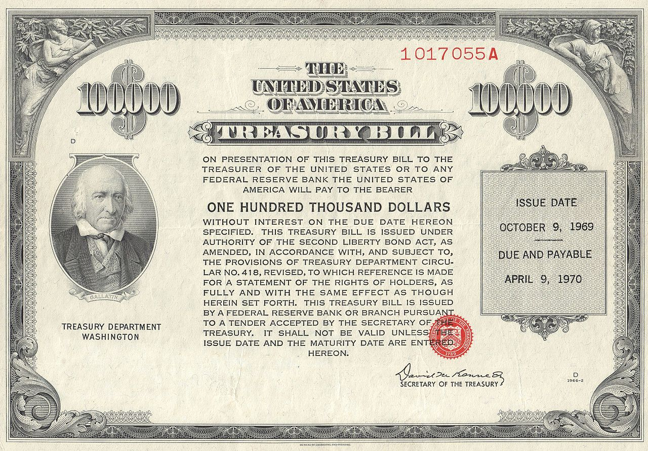
Problem Statement
Goal: To answer the following question: “for i in range(1,n): f ” Where will be 10-year U.S. Treasury Closing Yields be {i} days from now?”
Price Prediction of U.S. Sovereign Debt has an infinite amount of value both for the Private and Public Sector
Recursive Neural Networks and Deep-Learning models can potentially provide an advantage over more conventional models in Time Series Analytics, and has yet to be adopted as the Industry Standard despite arguably superior performance.
Source:
JHerbstman - Own work, The Joe I. Herbstman Memorial Collection of American Finance

Slide 3
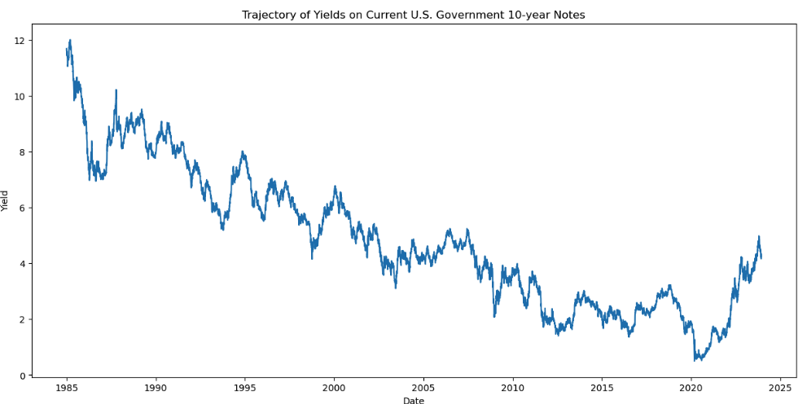
Data overview and approach
Downloaded Publicly Available Data from Yahoo Finance (US Treasury Note data may be the most prevalent time series in all of financial price data).
Model: Recursive Neural Network using LSTMs
Evaluation: Standard neural network evaluation looking for training thresholds that mark the eventual divergence between validation loss and training loss. Score: Negative Mean Squared Error (to maintain consistency with target-data units).

Slide 4
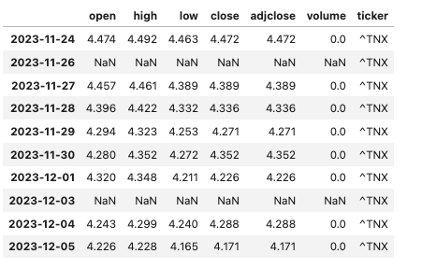
Proposed Modeling Approaches
Data used is daily close prices of the current on the run 10-Year U.S. Treasury note.
Data reaches back to Jan 1, 1985 to current day (last Friday, December 1st)
Missing values were prevalent in the beginning: used linear interpolation rather than smooth moving averages to better account for N/A values (more realistic given volatile environments from an industry practice standpoint).
Created 2 –Models:
Univariate which only uses the time series data with no feature engineering beyond filling missing values
Multivariate data which uses day of the week, month of the year, and week number of the year as dummy variables to help better capture historical seasonality patterns.

Slide 5
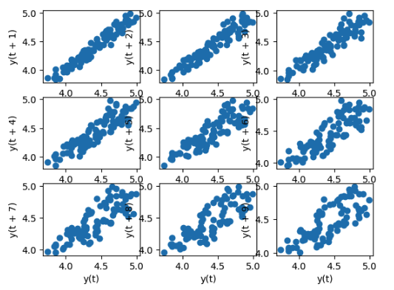
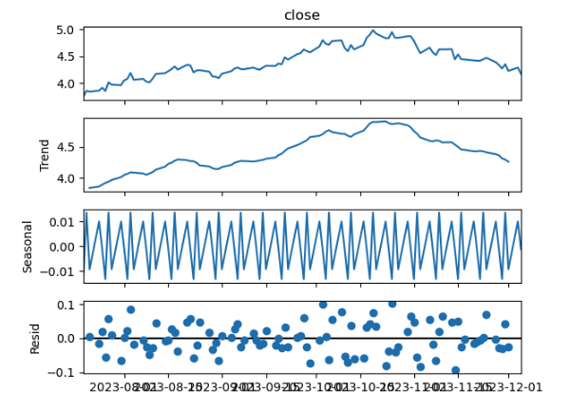
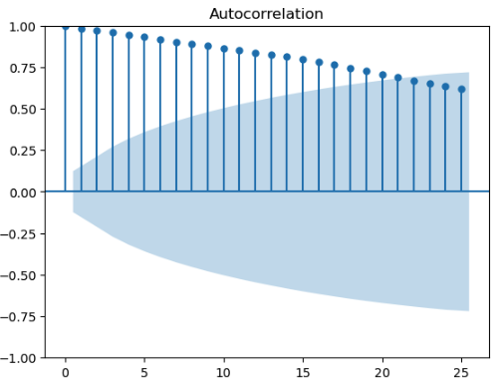
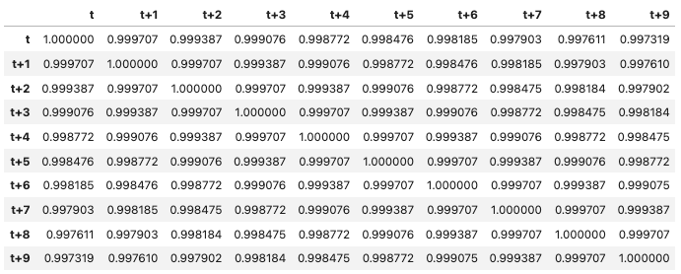
Feature Engineering
Confirmed the existence of seasonality but running seasonal decomposition of price action in various intervals.
Created dummy variables for key seasonal indicators following the seasonality analysis.
Ran Auto-Correlation Analysis, and created dummy variables.
Created month, weekday, week number variables

Slide 6
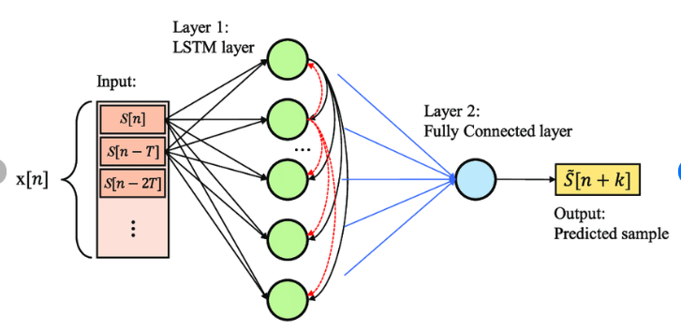
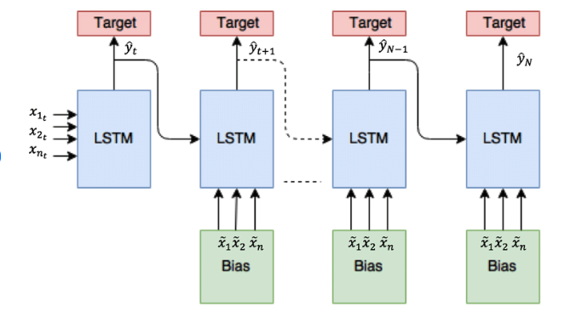
Proposed Modeling Approaches
Univariate LSTM RNN:
The only input being the price history (time series itself), splitting the data into training and testing at the x% threshold.
Multivariate LSTM RNN:
Inputs still restricted to being sourced from the price history itself, but adding dummy variables for the day of the week, the month, and the numbered week of the year (1 – 52 etc.)
Improving Long-Horizon Forecasts with Expectation-Biased LSTM Networks - Scientific Figure on ResearchGate. Available from: https://www.researchgate.net/figure/Multivariate-LSTM-with-4-features-and-a-single-output-The-output-of-LSTM-at-time-t-is_fig5_324600237 [accessed 8 Dec, 2023]
Deep Neural Networks for Multivariate Prediction of Photovoltaic Power Time Series - Scientific Figure on ResearchGate. Available from: https://www.researchgate.net/figure/Architecture-of-the-basic-LSTM-network-for-univariate-prediction-fed-by-the-vector-xn_fig1_347083182 [accessed 8 Dec, 2023]

Slide 7
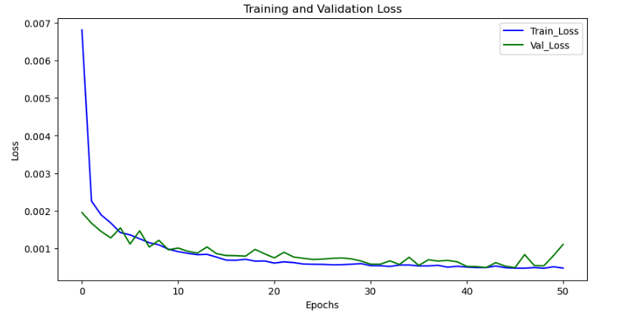
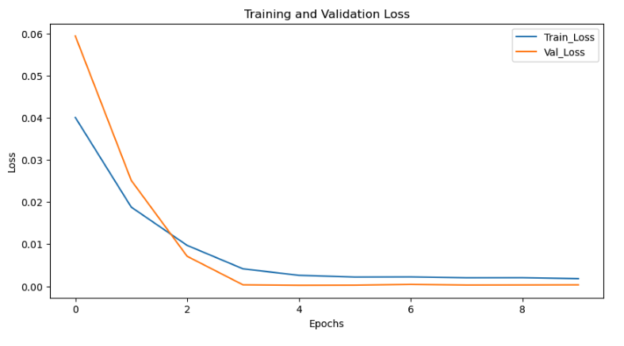
Regularizing Via Loss Chart, Evaluating Through MSE
Multivariate Model
Univariate Model

Slide 8
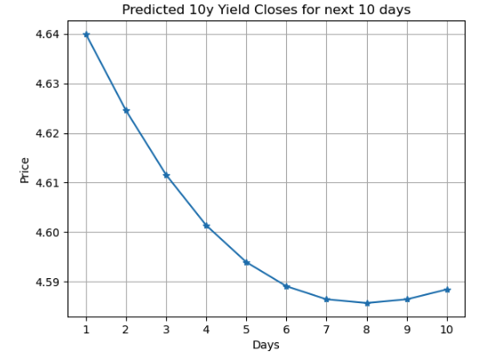
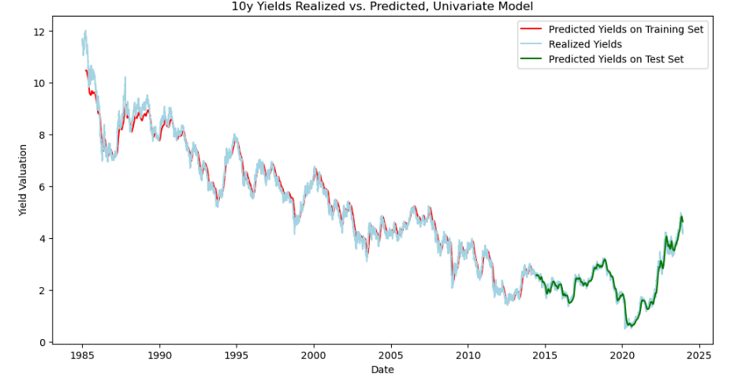
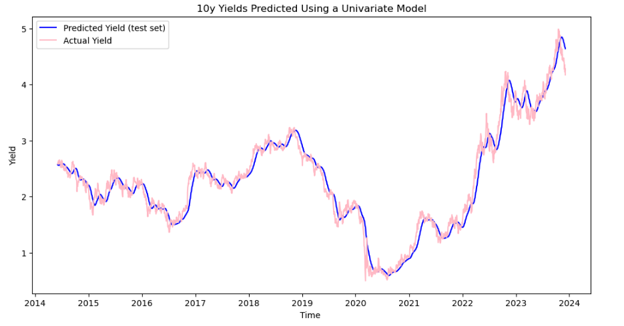
Results: Univariate Model

Slide 9
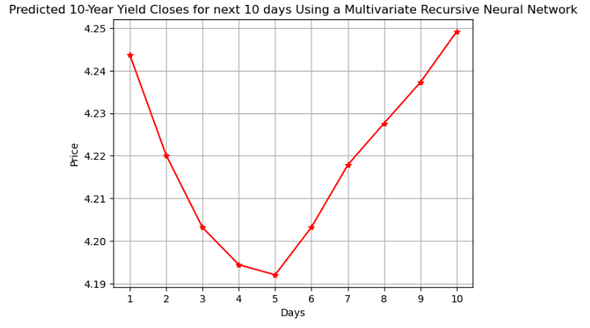
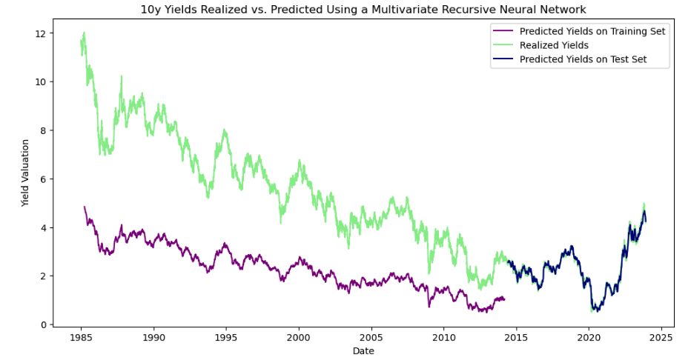
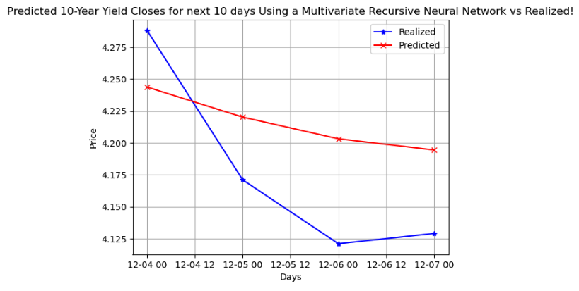
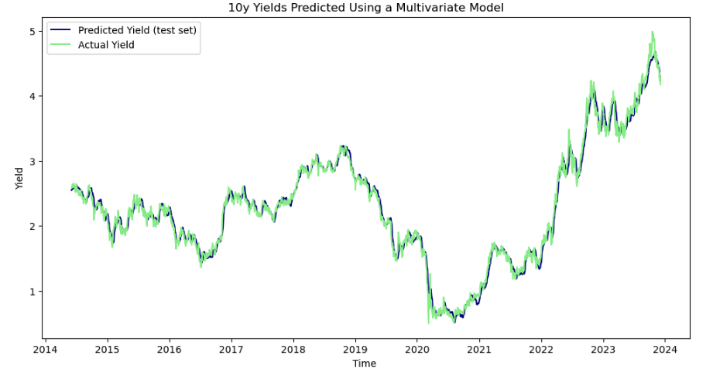
Results: Multivariate Model

Slide 10

Future Work
Increasing complexity of both the neural network itself, as well as the covariate complex, adding in both macroeconomic data variables (inflation, demographics, population growth) as well as other financial assets (Gold, FX, Equities etc.)
Explore regularization processes not able to be explored earlier. Also, expand the parameter and hyperparameter search universe by using randomized search CV, etc. Explore more epochs (double descent?), change batch and unit sizes, look to find optimal drop-out levels in the LSTM itself, etc.
Apply to portfolio construction and other financial assets, see whether or not a RNN process could be used effectively in trading and risk-taking / alpha generation.

